Slide 1

Wiki Gaming
The Larger Group
Intro
1
Catalog
2 3
User Forms
4
Accounts
5
Voting
6
Marketing
7

Slide 2
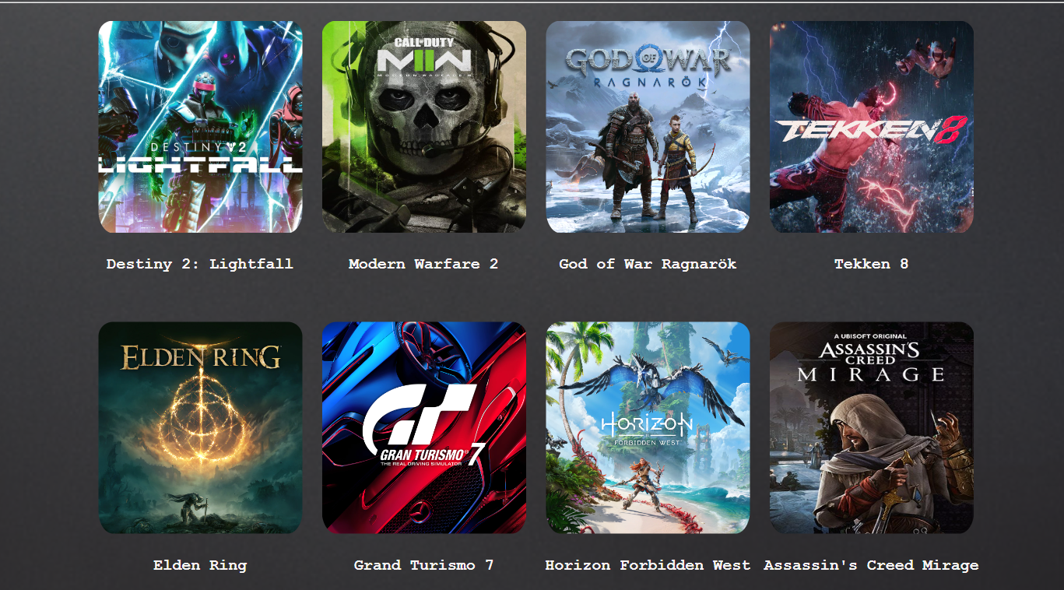
The Catalog
Displays Games
Add To Cart and Bookmarking
Intro
1
Catalog
2 3
User Forms
4
Accounts
5
Voting
6
Marketing
7

Slide 3
Individual Games
Pictures
Description
Comment Section
Intro
1
Catalog
2 3
User Forms
4
Accounts
5
Voting
6
Marketing
7

Slide 4
User Forms
Discussion Forms
Unique per Page
Intro
1
Catalog
2 3
User Forms
4
Accounts
5
Voting
6
Marketing
7

Slide 5
User Accounts
Personal Descriptions
Profile Picture
Comments
Bookmarks
Intro
1
Catalog
2 3
User Forms
4
Accounts
5
Voting
6
Marketing
7

Slide 6
Community Voting
Liking Games
Liking Comments
Intro
1
Catalog
2 3
User Forms
4
Accounts
5
Voting
6
Marketing
7

Slide 7
Marketing
Add To Cart
Purchasing Forms
Intro
1
Catalog
2 3
User Forms
4
Accounts
5
Voting
6
Marketing
7

